Slide 1


Section 3
Introduction to Azure Machine Learning

Slide 2
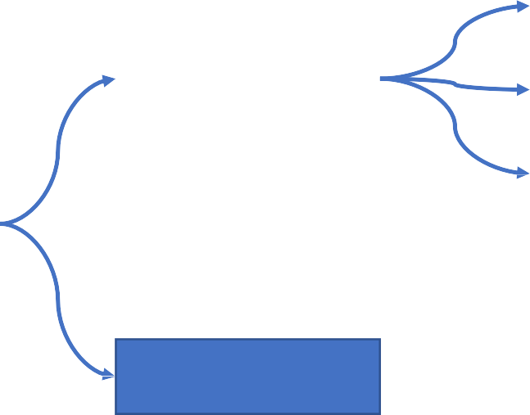



Azure Machine Learning – Azure ML Service
Azure Machine Learning service - A cloud-based platform for creating, managing, and publishing machine learning models.
Notebooks
Code with Python SDK
ML Studio
No-code ML
Automated ML
ML Designer
No-code ML
Azure ML
Data & Compute Management
ML Workspace
Pipelines
ML Types
ML Core Concepts
ML Core Tasks

Slide 3
Common Machine Learning Types

Slide 4
Machine Learning Types – Supervised ML Models
Supervised ML Model: training data includes known label values
Classification
predicting one of several categories or classes
Regression
predicting numeric values
Time-series forecasting
predicting numeric values based on time
Whether a patient is at risk of diabetes
whether tumor is benign or malignant
Categorize loan applications as low-risk or high-risk
Whether a loan will be repaid
Fraud detection
Object detection
The number of cars that will be sold next month
The price of a pre-owned car based on its maker, model, engine size, and mileage
The number of future car rentals
Predicting how many minutes a flight will be delayed based on weather information
The Carbon Dioxide Emissions by Energy Consumption Use in an area
Heights of ocean tides
Weather forecasting
Global temperature
Monthly counts of sunspot
Pollution levels
Blood pressure tracking
Heart rate monitoring
Population
Unemployment rates

Slide 5
Machine Learning Types – Unsupervised ML Models
Unsupervised ML Model: to separate inputs into clusters based purely on their characteristics, or features without a known label value
Clustering
group inputs into clusters based on the similarity of their features
Segment customers into different groups
Group cars of similar size or weight
Group penguins based their similarities
Image classification - group images that have similar characteristics
Face grouping – divide faces into groups
Feature: Shape
The minimum number of features: 1

Slide 6
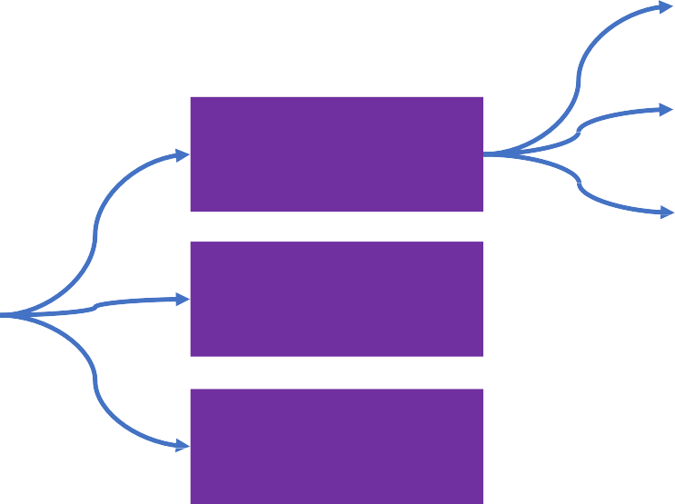
Machine Learning Types – Summary
Classification
Regression
Supervised Learning
Time-series Forecasting
Machine Learning Types
Unsupervised Learning
Clustering
Reinforcement Learning
Robotics
IoT

Slide 7
Core Machine Learning Concepts

Slide 8
Core ML Concepts – Features & Labels
Feature (Input)
x
Label (Output)
y
Function (f)
f (x) = y
Algorithms
Historical Data
Future Outcomes
Feature: Data values that influence the prediction of a model
Labelling: Process of tagging training data with known values

Slide 9
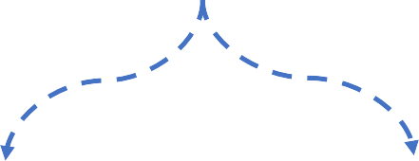
Core ML Concepts – Training and Validation Datasets
Split Data
Split Rows (one of the common techniques)
randomly split the data into rows for training and rows for evaluation/testing
Cross-validation
Iteratively test the trained model with data it wasn't trained with and compare the predicted value with the actual known value
Data
Data
Split data
Train Model
Split data
Train Model
Training Data
Evaluation Data
Training Data Subsets
Evaluation Data
Evaluate Model
Evaluate Model
Training Model
Should NOT evaluate the model using the same data that was used for training
Training Model

Slide 10
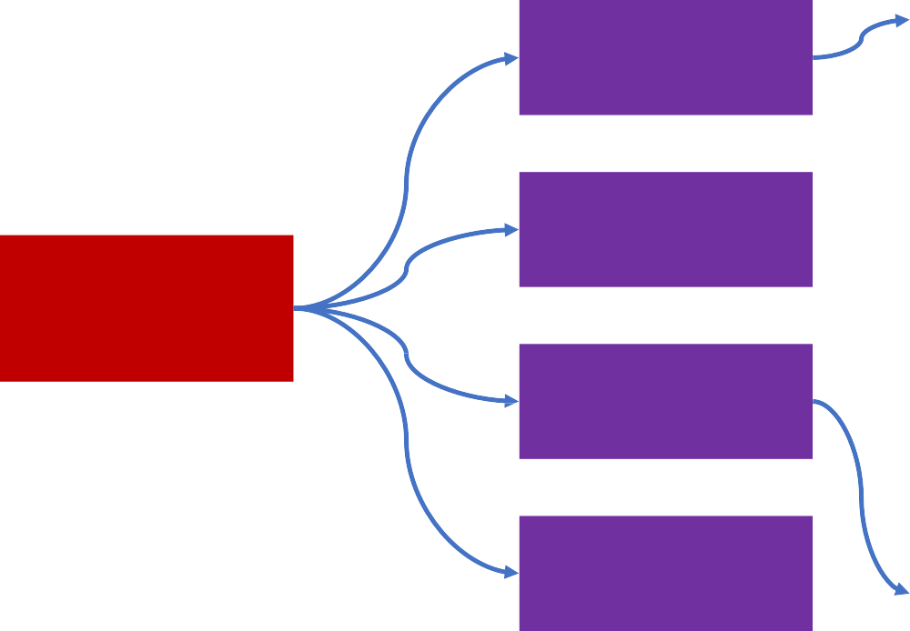
Core ML Concepts – Machine Learning Algorithms
Boosted Decision Tree Regression
Decision Forest Regression
Fast Forest Quantile Regression
Linear Regression
Text Analytics
Image Classification
Neural Network Regression
Additional Requirements
Poisson Regression
Accuracy
Extract Information
Classify Images
Regression
Predict Values
Bayesian Linear Regression
Training Time
Two-Class Classification
Two-Class Averaged Perceptron
Machine Learning Algorithms
Predict Categories
Two-Class Boosted Decision Tree
Two-Class Decision Forest
Two-Class Logistic Regression
Linearity
Multiclass Classification
Two-Class Neural Network
Two Class Support Vector Machine
Group Data
Number of Parameters
Multiclass Boosted Decision Tree
Multiclass Decision Forest
Detect Unusual Occurrences
Generate Recommendations
Clustering
Multiclass Logistic Regression
Multiclass Neural Network
Number of Features
Anomaly Detection
Recommenders
One vs. All Multiclass
One vs. One Multiclass
K-Means

Slide 11
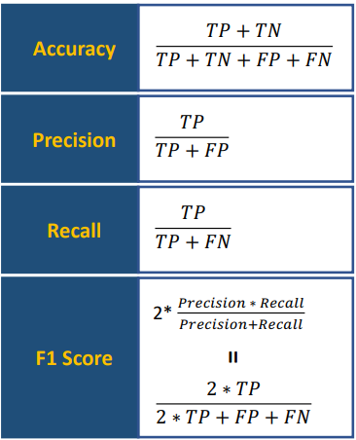









Core ML Concepts – Evaluation Metrics for Classification
Confusion Matrix
What’s the proportion of correctly classified instances?
Actual
1
0
What’s the percentage of the class predictions made by the model were correct?
True Positives | False Positives
False Negatives | True Negatives
1
Predicted
What’s the percentage of a certain class correctly identified?
0
The weighted average of precision and recall Closer to 1 the better

Slide 12
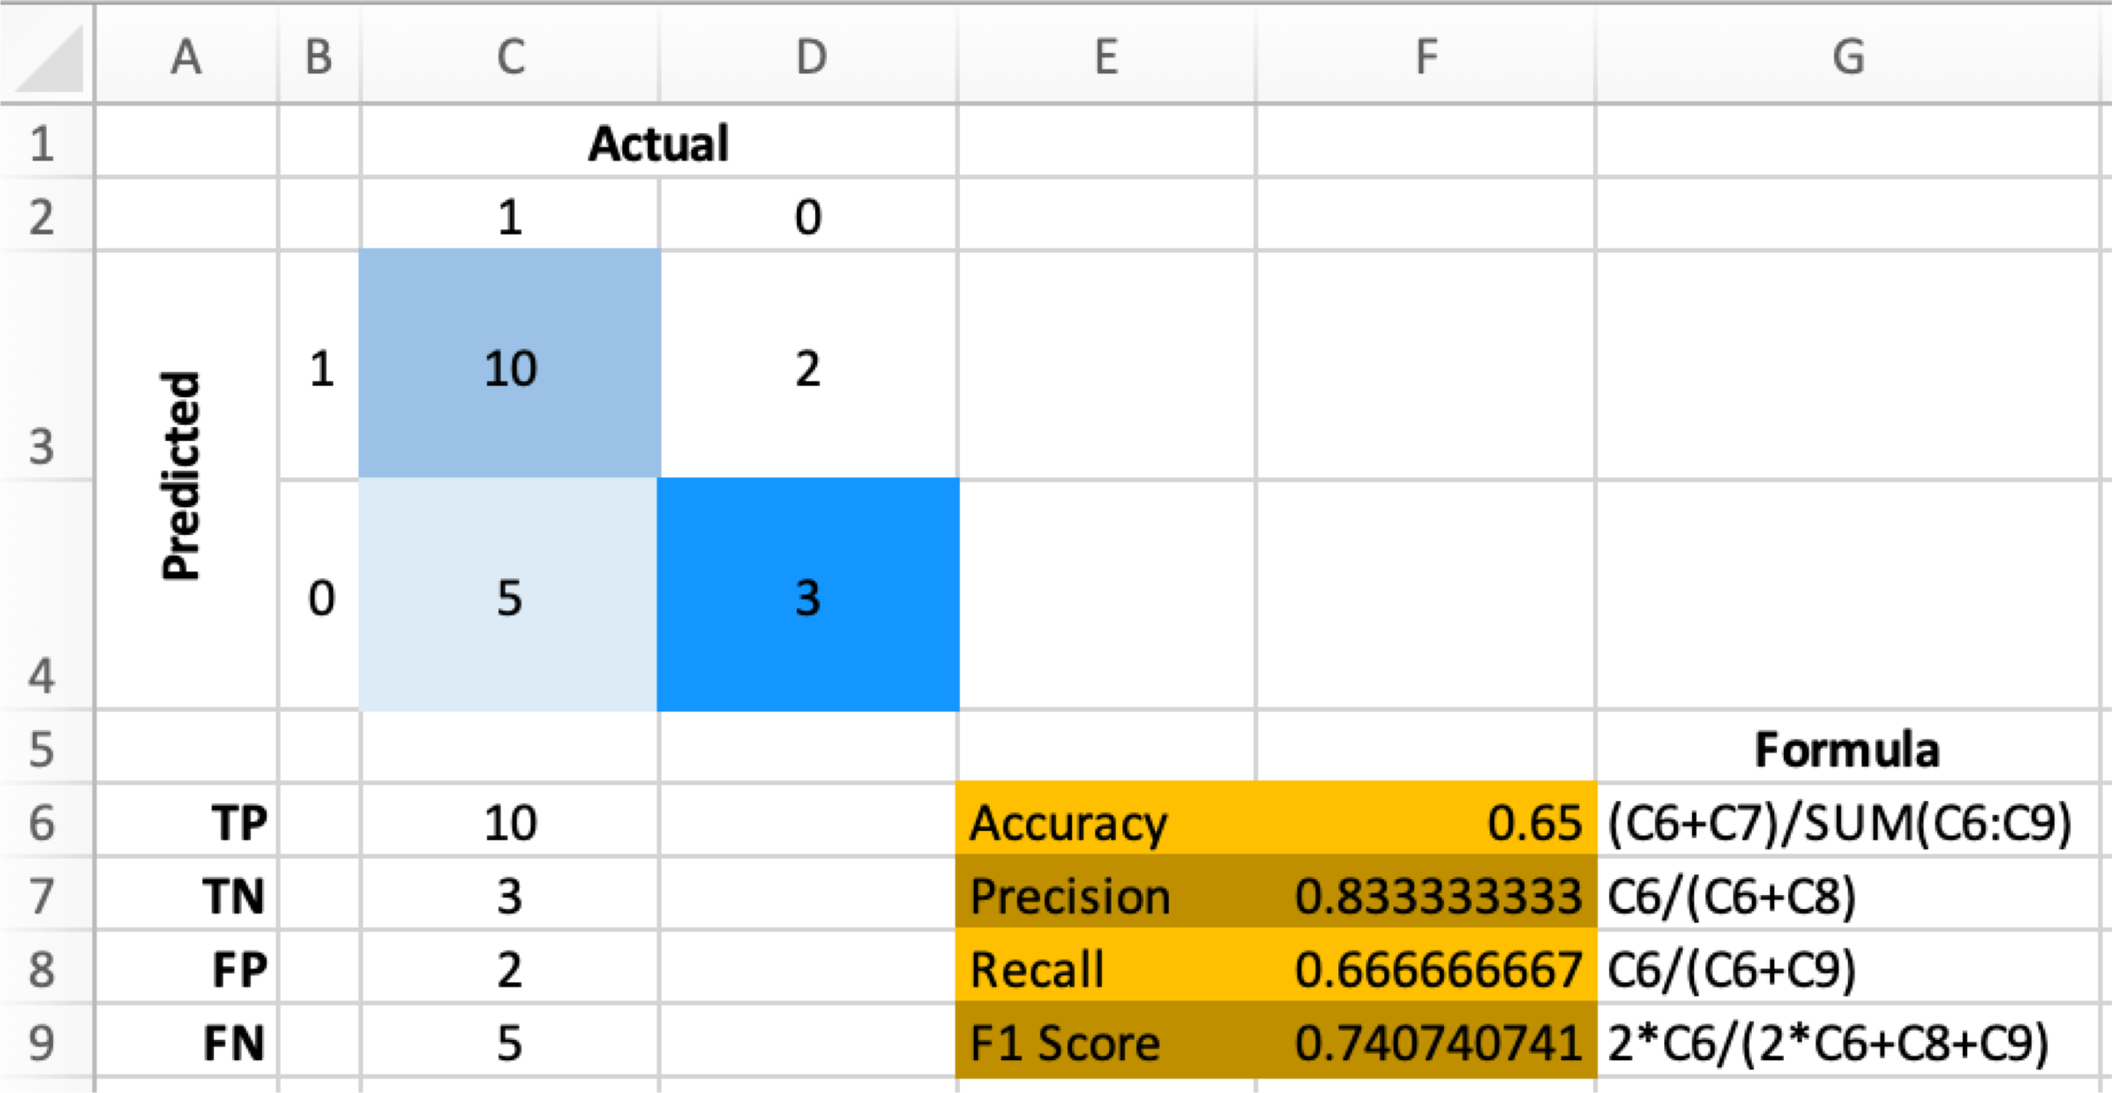



Core ML Concepts – Evaluation Metrics for Classification Example
Apple Classification
Predicted
Actual
YES
YES
TP
FP
NO
NO
FN
TN

Slide 13
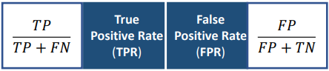
Core ML Concepts – Evaluation Metrics for Classification – ROC Curve & AUC
ROC Curve
(receiver operating characteristic curve)
Confusion Matrix
Actual
1
0
1
True Positives | False Positives
False Negatives | True Negatives
1
AUC
(area under the curve)
AUC = 1 Ideal
Predicted
TPR
0
AUC = 0.5
Random guessing (Y = X)
0
0
1
AUC < 0.5
Worse than random guessing
FPR
Ideal
Random Classifier
ROC Curve Example Bad Model Example
Recall

Slide 14
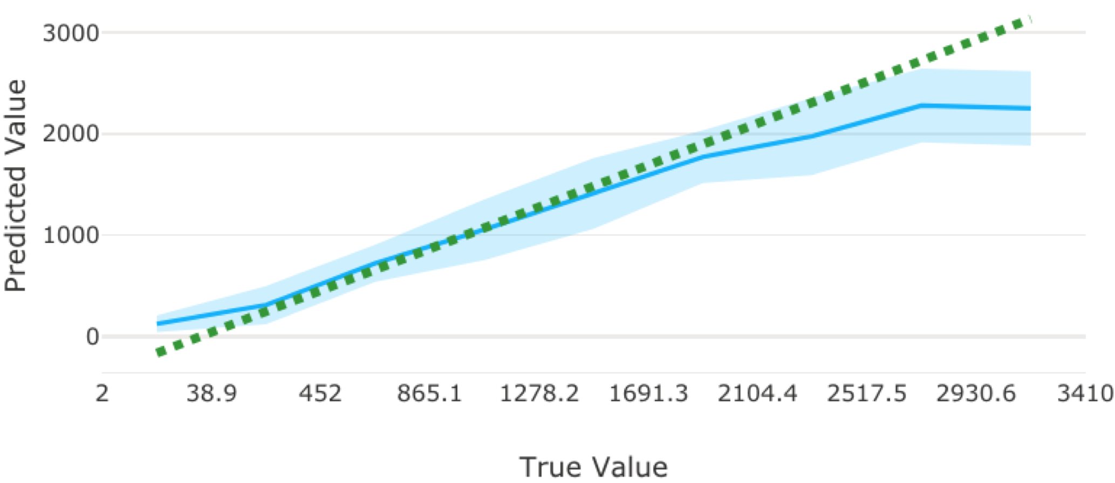
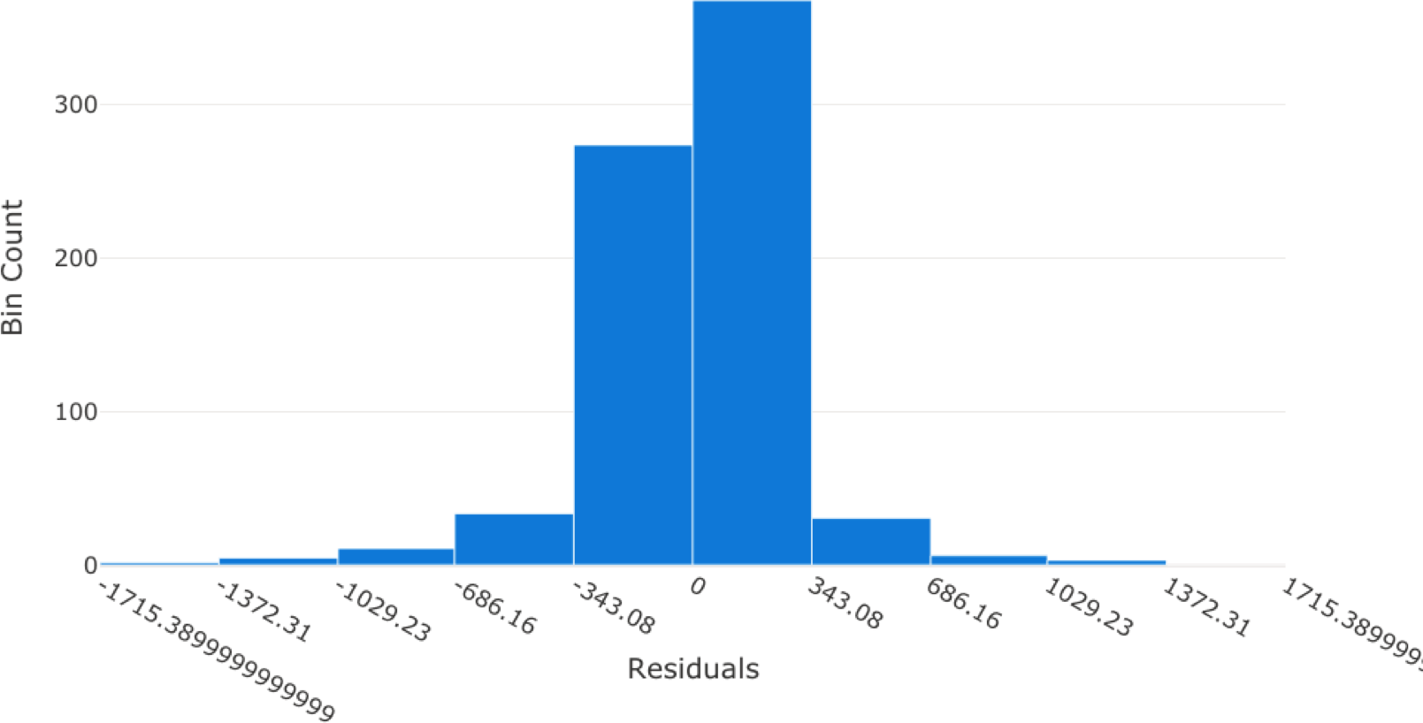
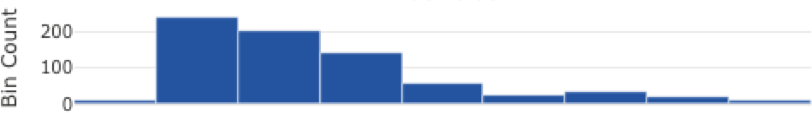
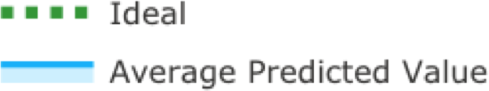
Core ML Concepts – Evaluation Metrics - Predicted vs. True
Predicted vs. True Residual Histogram
Residuals
Bad Model
Bad Model
The closer of frequently occurring residual values to 0, more accurate the ML model.
Shaded Aare: Variance of predictions around that mean predicted value
Bad Model Example
Residuals (Errors) - the difference between the predicted and actual value (label)
Residual Histogram – a diagram shows the frequency of residual value ranges

Slide 15
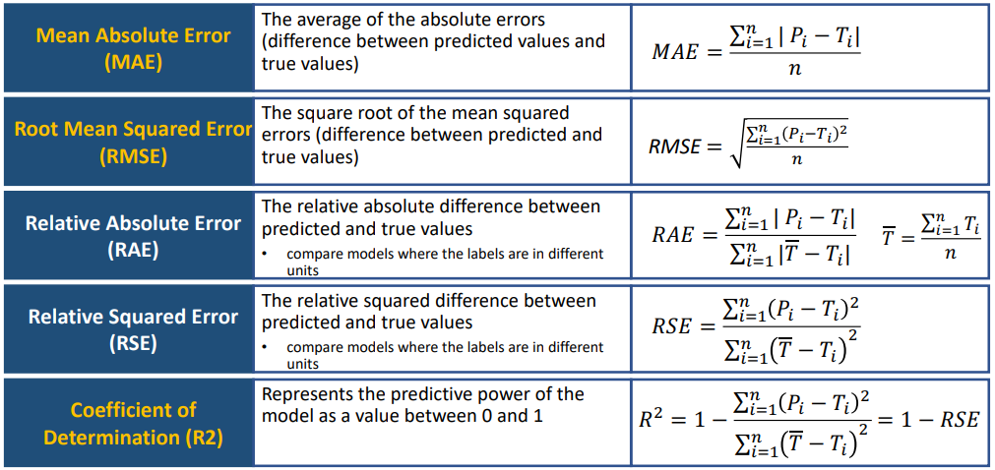
Core ML Concepts – Evaluation Metrics for Regression

Slide 16
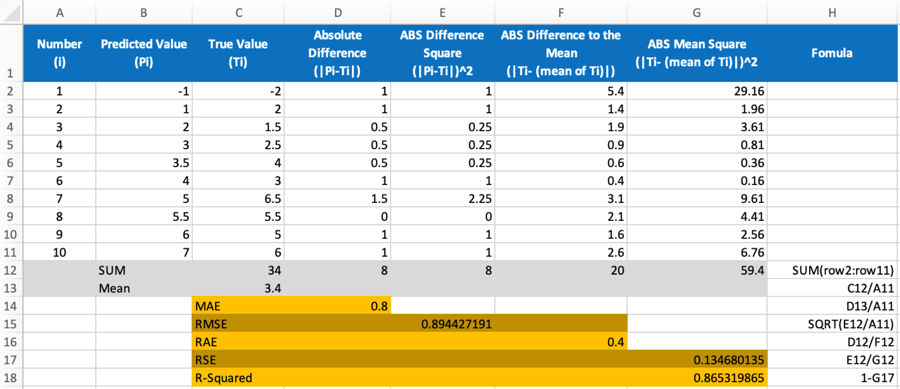

Core ML Concepts – Evaluation Metrics for Regression Example
Lower the value
the better
Closer to 0 the better
Closer to 1 the better

Slide 17
Machine Learning Solution Core Tasks

Slide 18

ML Solution Core Tasks Overview
Data Ingestion & Preparation
Step 1
Feature Engineering & Selection
Step 2
Core Tasks
Model Training & Evaluation
Step 3
Model Deployment & Management
Step 4
ML Pipelines

Slide 19
ML Solution Core Tasks – Data Ingestion
Create Datasets in Azure Machine Learning Designer (Recommended)
Azure cloud storages
Azure Blob Container
Azure File Share
Azure Data Lake
Azure Data Lake Gen2
Azure SQL Database
Azure Database for PostgreSQL
Databricks File System
Azure Database for MySQL
Datastore
Datasets
Local File
Public URL
Azure Open Datasets
Import Data module – import data from Azure cloud storages or public URLs
Enter Data Manually module – create a small dataset by manually entering values

Slide 20


ML Solution Core Tasks – Data Preparation Common Tasks
Exclude unwanted features (columns) from the dataset
Select Columns in
Dataset
Combine all columns from two or more datasets
Add Columns
Merge two datasets using a database-style join operation based on the key column, or Composite keys using multiple columns. Examples:
Join Data
Data Transformation
Inner Join – combined rows when the values of key column match
Remove Duplicate
Rows
ID | A | B
01 | XXX | XXX
02 | XXX | XXX
03 | XXX | XXX
ID | C
01 | XXX
02 | XXX
04 | XXX
ID | A | B | C
01 | XXX | XXX | XXX
02 | XXX | XXX | XXX
Clean Missing Data
Left Outer Join – keep left table
ID | A | B
01 | XXX | XXX
02 | XXX | XXX
03 | XXX | XXX
ID | C
01 | XXX
02 | XXX
04 | XXX
ID | A | B | C
01 | XXX | XXX | XXX
02 | XXX | XXX | XXX
03 | XXX | XXX
Normalize Data
Split Data
Key Column Missing value/ Replacement value
Remove potential duplicates from a dataset

Slide 21
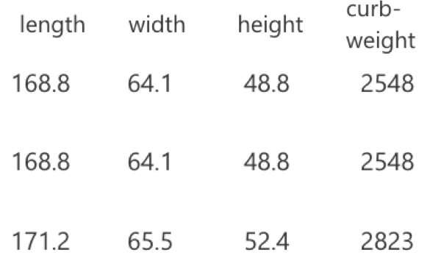

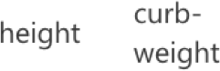
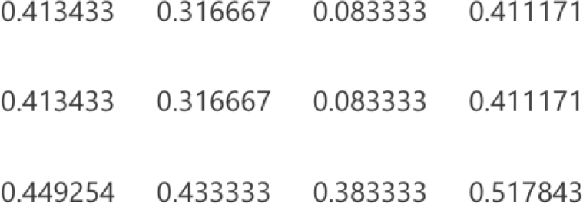
ML Solution Core Tasks – Data Preparation Common Tasks Cont.
Ignore, replace, or infer missing values
Examples:
Minimum missing value ratio - [0-1, default 0] the minimum portion of missing values to be operated
Maximum missing value ratio - [0-1, default 1] the maximum portion
of missing values to be operated
Custom substitution value
Replace with mean / median / mode
Remove entire row / column
Select Columns in
Dataset
Add Columns
Join Data
Data Transformation
Change the values of numeric columns to be on a common scale
Examples:
MinMax - Rescaling to the [0,1]
Remove Duplicate
Rows
Significantly larger values
may lead to higher bias
Clean Missing Data
Normalize Data
Separate data into training and validation datasets
Examples:
Split Rows - [0-1, default 0.5] the fraction of rows in the first output dataset
For example, if the value is 0.7, then the dataset is divided 70/30
Split Data

Slide 22
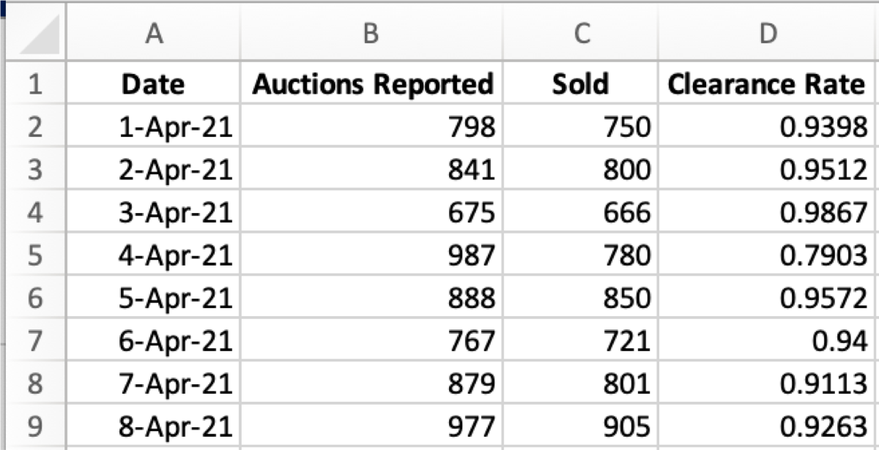
ML Solution Core Tasks – Feature Engineering & Selection
Feature Engineering
The process of creating new features from original data to help machine learning algorithms to learn better
Automation – Featurization
Automatically pre-process the features before training
Feature Type: DateTime
Engineer Features:
Features (Columns)
Observation / Record (Rows)
Year
Month
Day
Feature Selection
Day of week
Day of year
Quarter
Week of the year
Hour
Minute
Second
The purpose is to narrow the features by selecting a subset of relevant, useful features of original data to reduce noise and improve training performance
The process of applying statistical tests to the input datasets to determine which columns are more predictive of the output

Slide 23
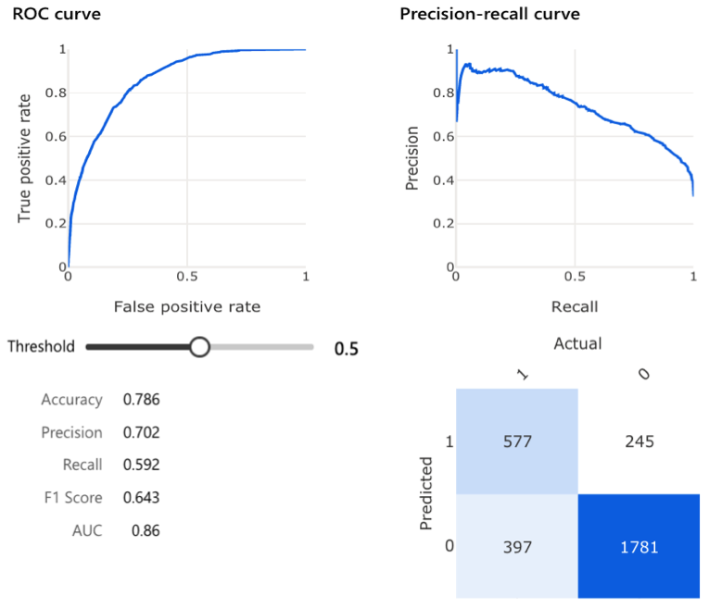
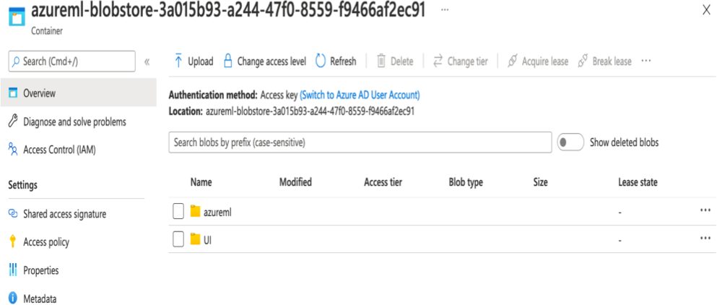
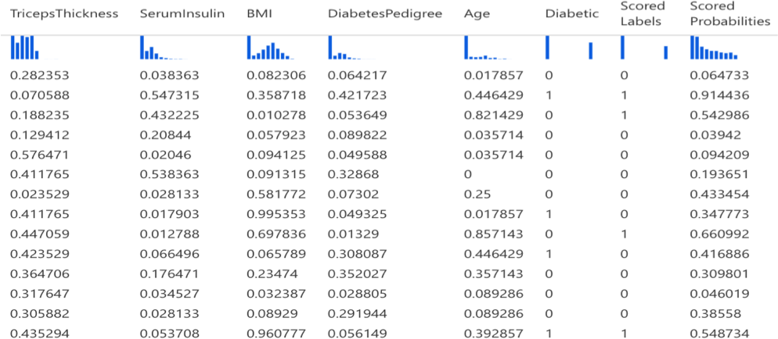
ML Solution Core Tasks – Model Training & Evaluation
 | Train Model
Purpose | Train a ML model Train Model module – for a regression or classification model Train Clustering Model module – for a clustering model Input: dataset for training and algorithm K-means clustering Number of centroids parameter – the number of clusters for the model
Azure ML Module
Input / Output
Score Model
Evaluate Model
Generate predictions on new actual data
Score Model module – for a regression or classification model
Assign Data to Clusters module – for a clustering model
Input: dataset for validation (Split Data)
Measures the accuracy of a trained model
Evaluate Model module – for a regression or classification or clustering model
Output: evaluation metrics for comparison of the performance of multiple training models

Slide 24


ML Solution Core Tasks – Model Deployment & Management
Production (Real-time Inference)
Compute Target
Inference Clusters
Azure Kubernetes Service (AKS)
Trained Model
Azure Container Instance (ACI)
Predict Outcomes
Development and Testing
New Data

Slide 25
ML Solution Core Tasks – Building Azure ML Pipelines
Azure Machine Learning Pipelines
Orchestrate data preparation, model training, deployment, and tasks management
Help automate machine learning workflows
Data Ingestion & Preparation
Training Pipeline
Feature Engineering & Selection
Model Training & Evaluation
Inference Pipeline
Model Deployment & Management

Slide 26
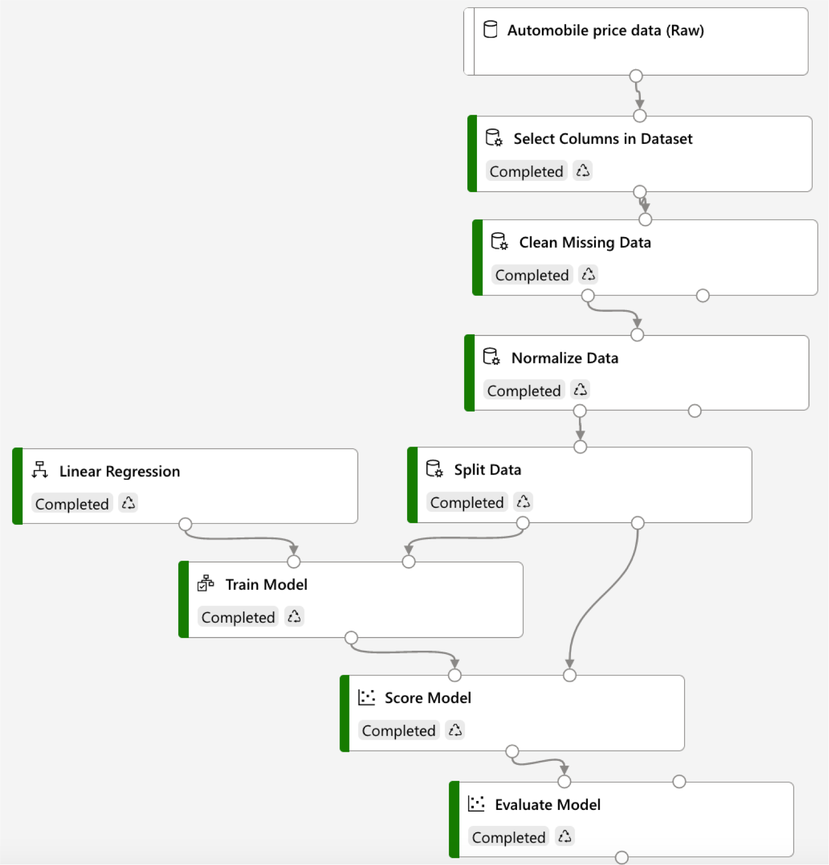
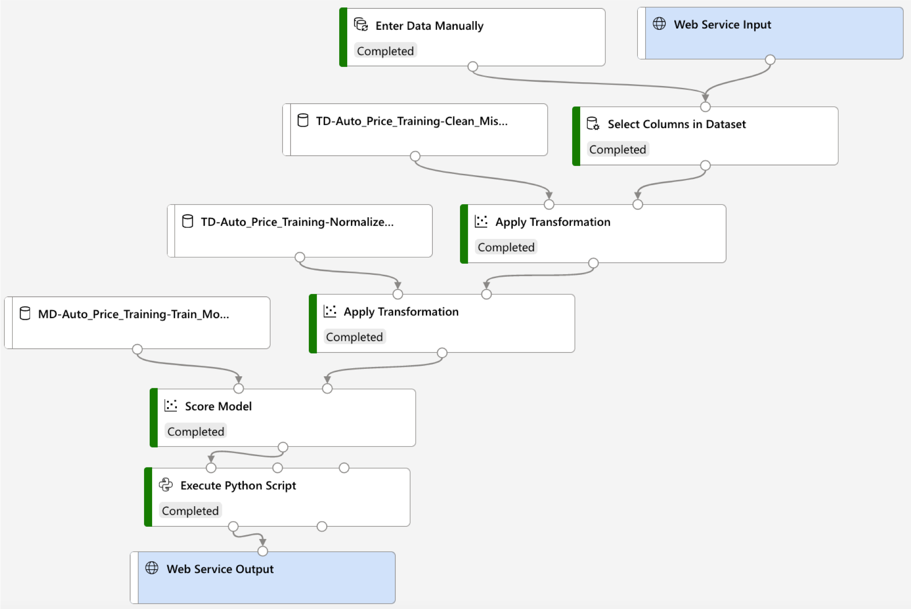
ML Solution Core Tasks – Creating Pipelines – Regression Model
Training Pipeline Inference Pipeline
Data Preparation
Algorithm Selection
Training
Scoring
Evaluation
Trained Model
Asset Reused

Slide 27
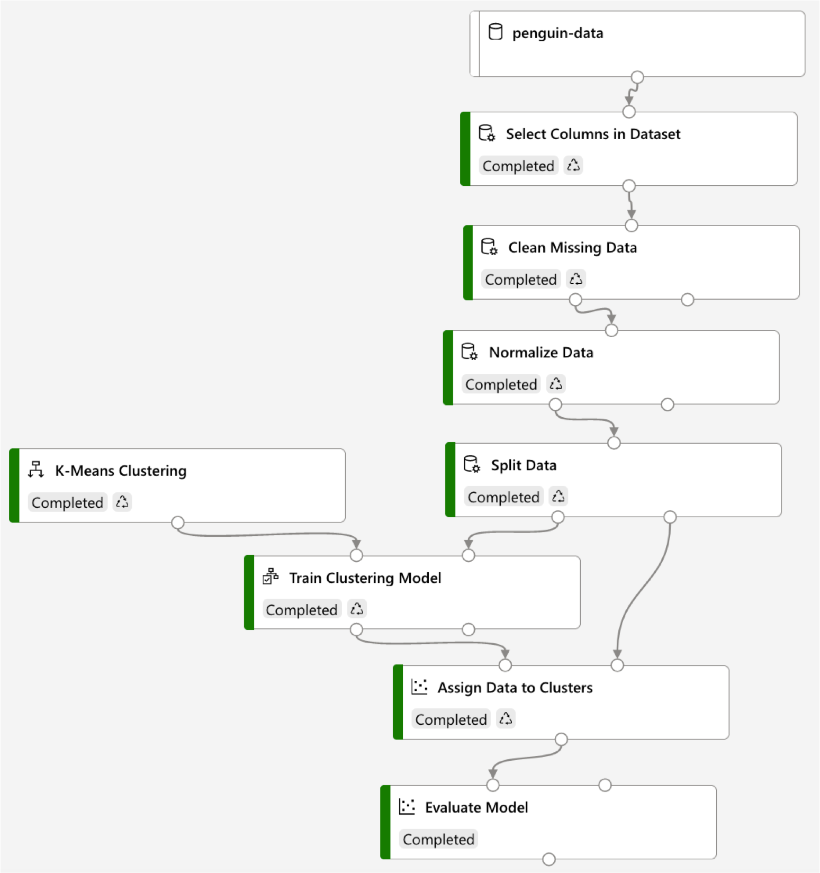
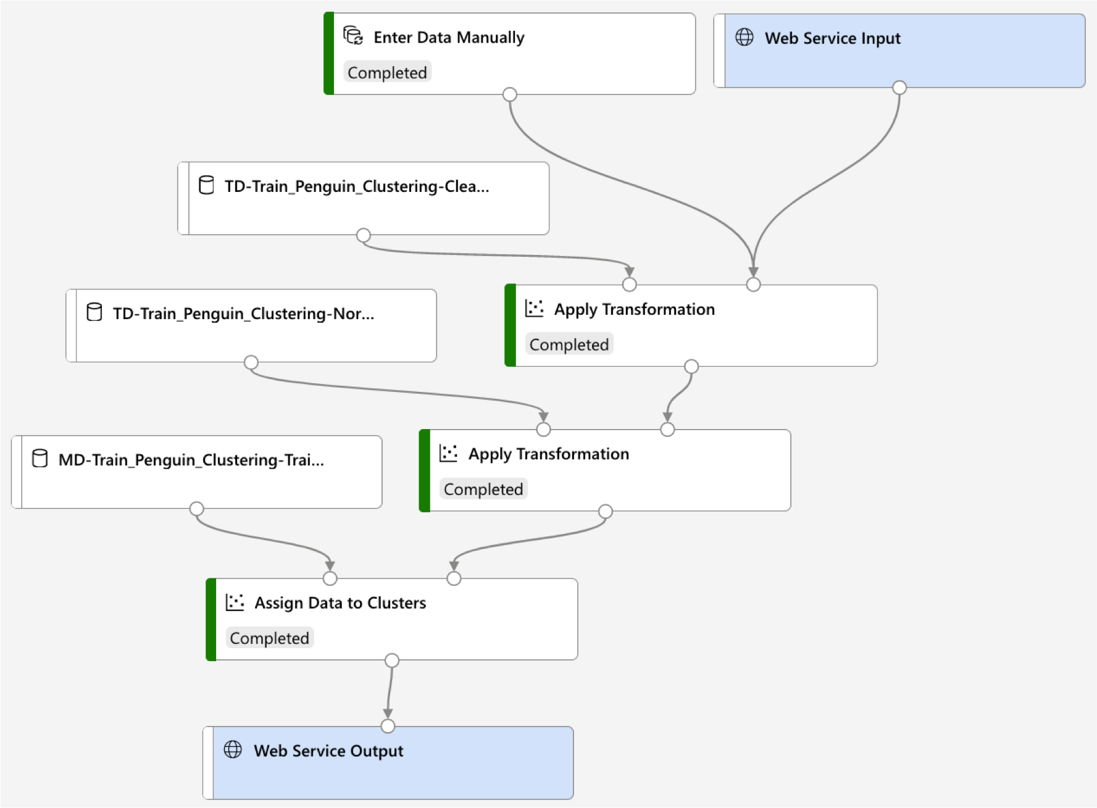
ML Solution Core Tasks – Creating Pipelines – Classification Model
Training Pipeline Inference Pipeline
Data Preparation
Algorithm Selection
Training
Scoring
Evaluation
Trained Model
Asset Reused

Slide 28
Azure Machine Learning Workspace

Slide 29
Azure Machine Learning – Workspace
Azure Machine Learning Workspace
A centralized place to manage data, compute resources, code, models, and other artefacts related to your machine learning workloads.
Workspace Management
Business/Data Experts
No Code
Programmer
Coding
Task | Azure Portal | Azure ML Studio | Python SDK / R SDK | Azure ML CLI | Visual Studio Code
Create a workspace | X |  | X | X | X
Manage workspace access | X |  |  | X
Create and manage compute resources | X | X | X | X
Create a Notebook VM |  | X

Slide 30







Azure Machine Learning – Workspace Architecture
Azure Blob Storage
Stores artefacts & logs • Registers docker
Default datastore containers
Stores secrets
Stores monitoring information about the models
Lazy-loaded - ACR is only created when deployment images are created
Azure File Share
Stores Jupyter notebooks
Associated Azure Resources
Create Resources
Azure Portal
https://portal.azure.com
Compute
Instances
Fully managed VMs
Development workstations
Storage Account
Container Registry
Key Vault
Application Insights
Create Workspace
Compute
Clusters
Scalable clusters of VMs
Compute targets for on- demand processing of experiment code
Dependencies
Managed Resources
Azure ML Workspace
Azure ML Studio
https://ml.azure.com
Datastore
Manage Assets and Resources
Linked Services
Assets
Compute Targets
Environments
Experiments
Pipelines
Datasets
Models
Endpoints
Inference
Clusters
Attached
Compute
Python packages
Environment variables
Software settings
Groupings of many runs (execution of a training script)
Workflows of machine learning tasks
Reference to the data source location and its metadata
Trained files to recognize certain types of patterns
Instantiation of ML models
Deploy models to Azure Kubernetes Service for real- time inferencing
Links to existing Azure compute resources (VMs or Azure Databricks clusters)

Slide 31
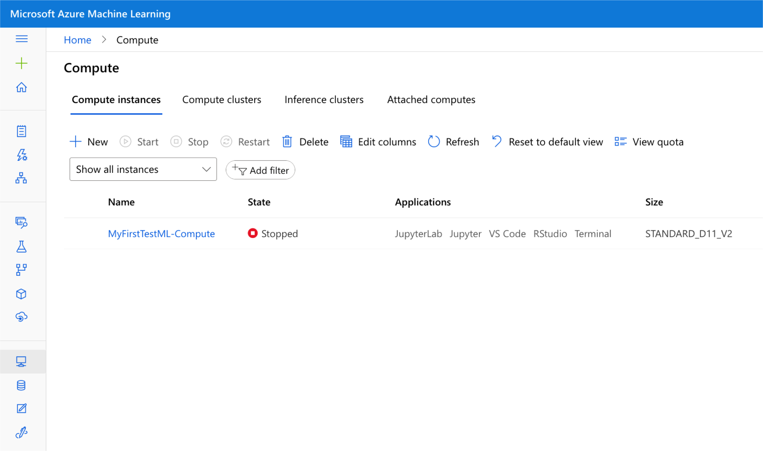
Azure Machine Learning – Compute Resource
Compute
Links to existing Azure compute resources (VMs or Azure Databricks clusters)
Fully managed VMs
Development workstations
Run Jupyter Notebooks
Deploy models to Azure Kubernetes Service for real- time inferencing (Production)
Scalable clusters of VMs
Compute targets for on-demand processing of experiment code
Run Training Pipelines
Run Inference Pipelines

Slide 32
Creating an Azure ML Workspace
Demo
in
Azure Portal

Slide 33
No-code
Machine Learning with
Azure ML Studio #1 AutoML

Slide 34
Azure Machine Learning – Automated ML (AutoML)
AutoML - the process of automating the time-consuming, iterative tasks of machine learning model development
Feature Selection
Model Optimization
Algorithm Selection Parameter Tuning
Best Model
 | A | B | C | D
62%
86%
43%
79%
75%
78%
86%
81%
56%
93%
69%
70%
Trained Model
84%
83%
75%
95%
Classification
Regression
Time-series Forecasting
91%
59%
82%
84%

Slide 35
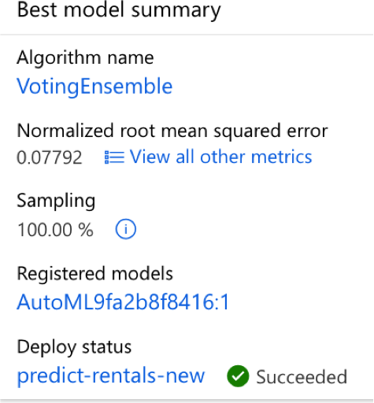
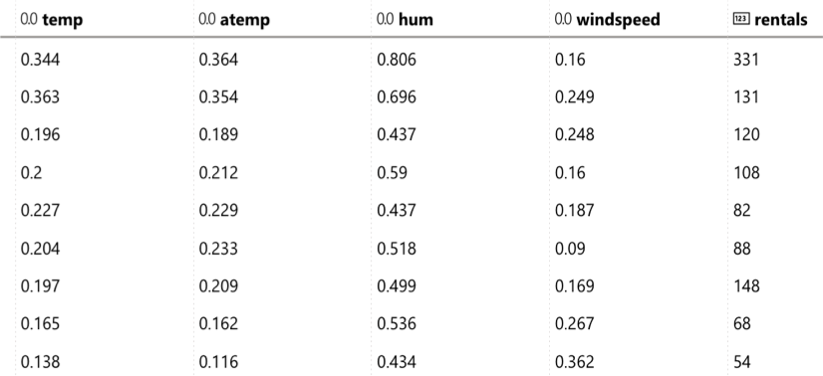

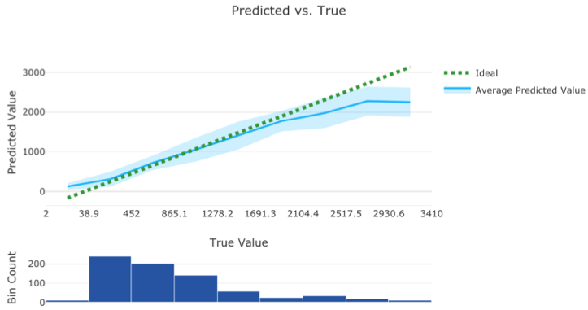
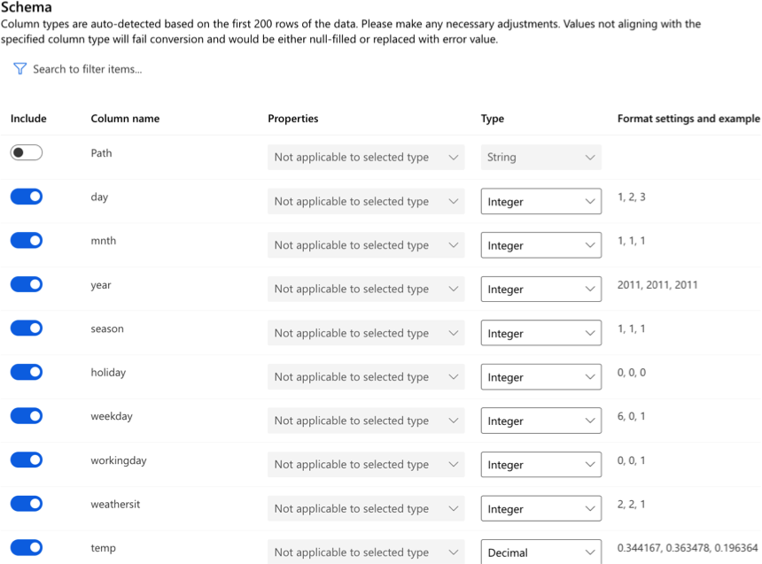
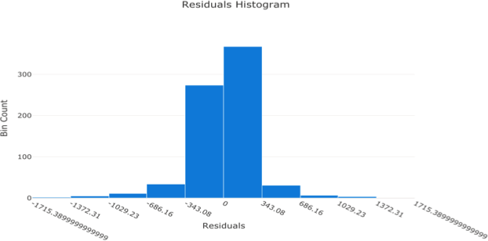

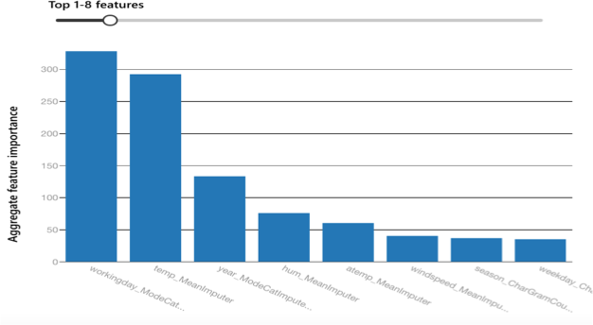
Azure Machine Learning – AutoML Model Training Steps
Create Dataset | Create Experiment | Train Model | Evaluate Model | Deploy Model
Upload dataset
Production
(Real-time Inference)
Azure Kubernetes Service (AKS)
Model Selection
Classification
Regression
Time series forecasting
Feature Selection
Automated Training
Settings
Algorithm selection
Parameter setting
Featurization
Development & Testing
Azure Container Instance (ACI)

Slide 36
Training a Regression Model
Hands-on Lab
with
Azure Automated ML

Slide 37
No-code
Machine Learning with
Azure ML Studio #2 Designer

Slide 38
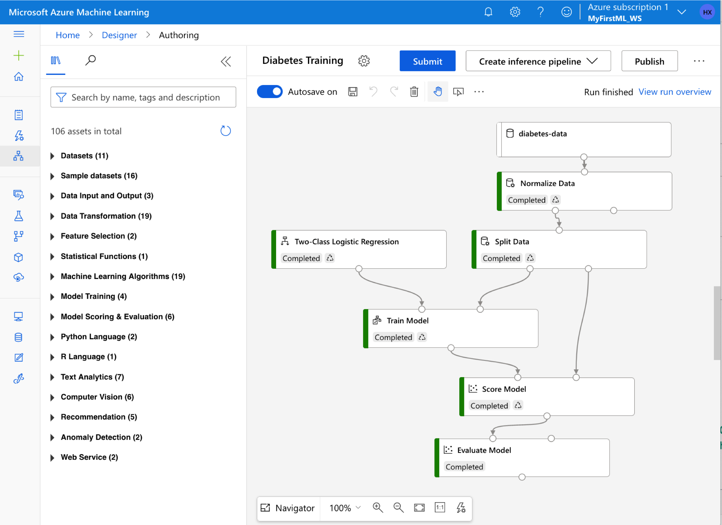
Azure Machine Learning – ML Designer
Azure ML designer provides a drag-and-drop visual canvas to build, test, and deploy ML models.
Datasets
Modules
Pipelines
Supported open-source frameworks
MLflow
Kubeflow
ONNX (Open Neural Network Exchange)
PyTorch
TensorFlow
Supported programming languages
Python and R

Slide 39
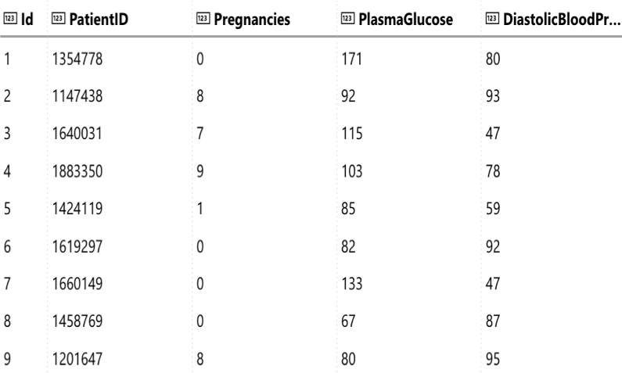
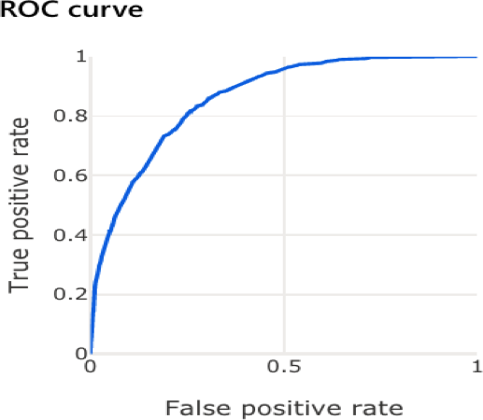
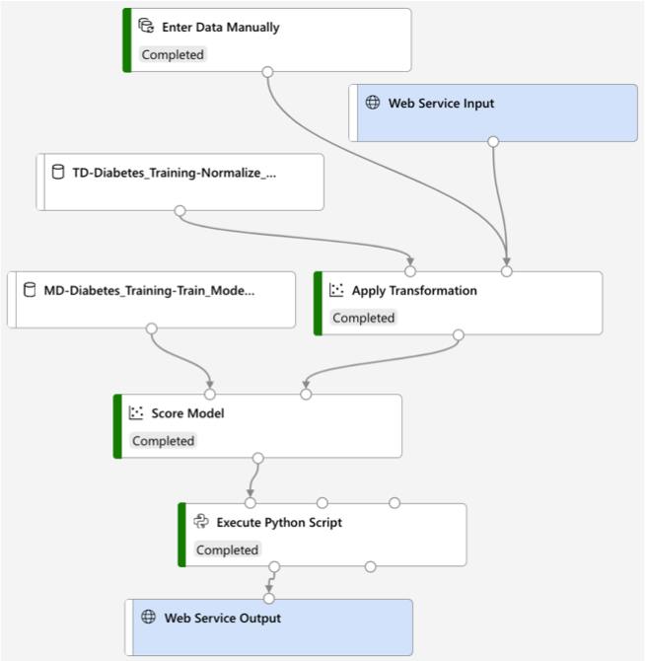
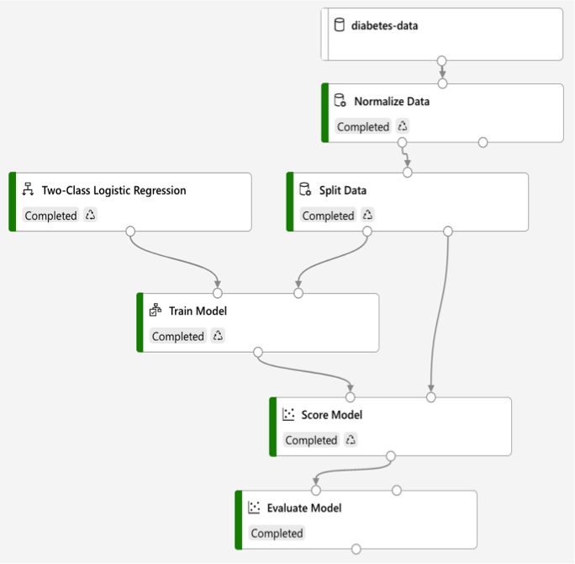
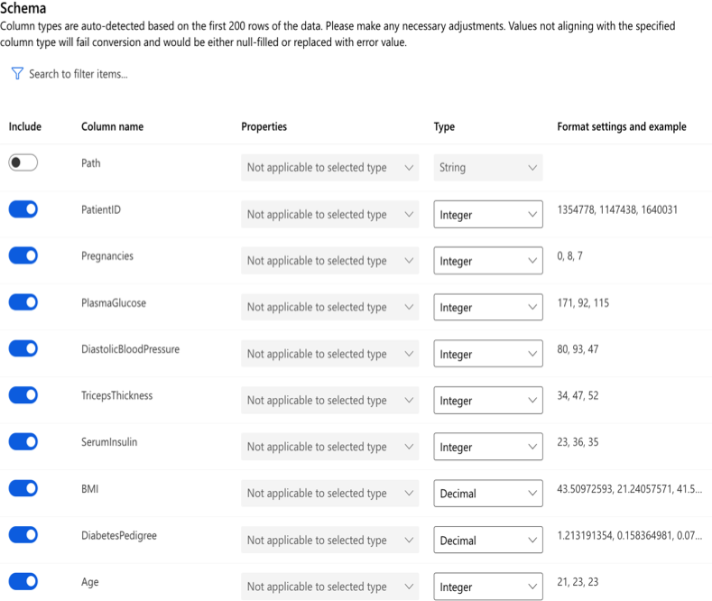
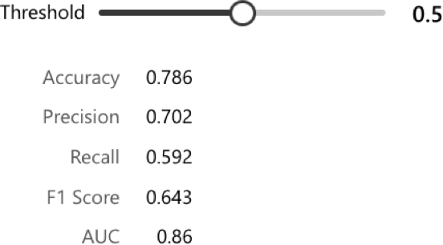
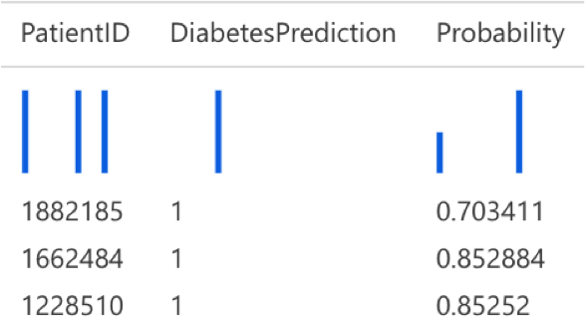
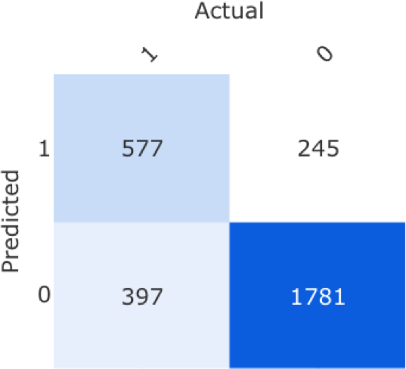
Azure Machine Learning – ML Designer Model Training Steps
Create Dataset | Create Training Pipeline | Evaluate Model | Create Inference Pipeline | Deploy Model
Upload dataset
Feature Engineering & Selection
Model Selection Algorithm selection
Production
(Real-time Inference)
Azure Kubernetes Service (AKS)
Feature Selection
Development & Testing
Azure Container Instance (ACI)
Run the Inference Pipeline
Run the training Pipeline

Slide 40
Training a Classification Model
Hands-on Lab
with
Azure ML Designer

Slide 41
Azure Machine Learning Summary

Slide 42








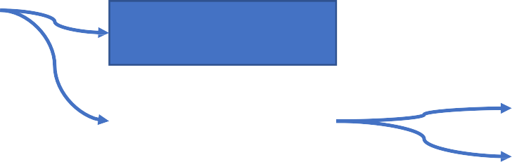


Azure Machine Learning Summary
Regression
Classification
Time-series Forecasting
Clustering
Classification Model
Regression Model
Confusion Matrix
Accuracy
Precision
F1 Score
ROC Cure & AUC
Supervised Learning
Unsupervised Learning
ML Types
MAE
RMSE
Reinforcement Learning
Select Columns in Dataset
Add Columns
Join Data
Remove Duplicate Rows
Clean Missing Data
Normalize Data
Split Data
Features & Labels Datasets
Algorithms
Evaluations Metrics
Data Ingestion & Preparation
Feature Engineering & Selection
Model Training & Evaluation
Model Deployment & Management
RAE
RSE R2
ML Core Concepts
Machine Learning
ML Core Tasks
Train Model
Score Model
Evaluate Model
Data & Compute Management
Pipelines
Automated ML
ML Designer
Azure ML
Training Pipeline
ML Workspace
Inference Pipeline
ML Studio

